Slide 1
Project ppt
Project name: Steganography
Project members: Harsh patel
keyur patel
Tanmay kshirsagar

Slide 2
What is Steganography?
Steganography is the practice of hiding private or sensitive information within something that appears to be nothing out to the usual. Steganography is often confused with cryptology because the two are similar in the way that they both are used to protect important information. The difference between two is that steganography involves hiding information so it appears that no information is hidden at all. If a person or persons views the object that the information is hidden inside of he or she will have no idea that there is any hidden information, therefore the person will not attempt to decrypt the information.
What steganography essentially does is exploit human perception, human senses are not trained to look for files that have information inside of them, although this software is available that can do what is called Steganography. The most common use of steganography is to hide a file inside another file.

Slide 3
Why this steganography
This technique is chosen, because this system includes not only imperceptibility but also un-delectability by any steganolysis tool.
Project Scope:
This project is developed for hiding information in any image file. The scope of the project is implementation of steganography tools for hiding information includes any type of information file and image files and the path where the user wants to save Image and extruded file

Slide 4
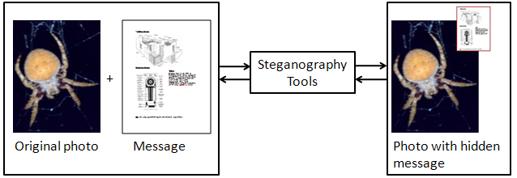
Example

Slide 5
Thank you

